Slide 1
Network Security
Prof. Ramesh Ragala

Slide 2
Introduction
Most security problems are intentionally caused by malicious people trying to gain some benefit, get attention, or to harm someone
Network security problems can be divided roughly into four closely intertwined areas: secrecy, authentication, nonrepudiation, and integrity control.
Secrecy : (confidentiality) keeping information out of the hands of unauthorized users
Authentication: determining whom you are talking to before revealing sensitive information
Nonrepudiation: it deals with signatures

Slide 3
Introduction
Security is concern with one layers. Each layer something to contribute.
@ physical layer: wiretapping
@ data link layer: link encryption
@ network layer : firewall and IP security
@ Transport layer: end – to – end security
@ Application layer: authentication and nonrepudiation .

Slide 4
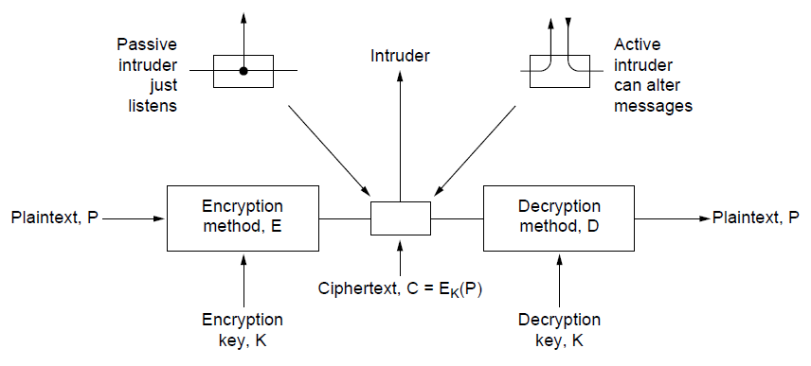
Encryption Model
Cryptography comes from the Greek words for ''secret writing.'‘

Slide 5
Encryption Model
The messages to be encrypted, known as the plaintext, are transformed by a function that is parameterized by a key.
The output of the encryption process, known as the cipher text, is then transmitted, often by messenger or radio.
intruder, hears and accurately copies down the complete cipher text.
Passive Intruder & Active intruder
The art of breaking ciphers, called cryptanalysis.
@ sender side : C = E_{K}(P)
@ Receiver side : P = D_{K}(C) → D_{K}(E_{K}(P) ) = p

Slide 6
Encryption Model
cryptanalyst knows the methods used for encryption and decryption.
Key is changing frequently. → length is major issue.
The idea that the cryptanalyst knows the algorithms and that the secrecy lies exclusively in the keys is called Kerckhoff's principle.
“Kerckhoff's principle: All algorithms must be public; only the keys are secret”.
Using secret algorithm → security by obscurity. → never works
Secrecy comes from having a strong (but public) algorithm and a long key

Slide 7
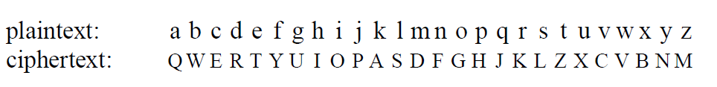
Encryption Methods
Encryption methods are divided into two categories: substitution ciphers and transposition ciphers.
Substitution ciphers:
each letter or group of letters is replaced by another letter or group of letters to disguise it.
Caesar cipher: In this method, a becomes D, b becomes E, c becomes F, ... , and z becomes C.
Another approach : cipher text alphabet to be shifted by k letters
Another approach:

Slide 8
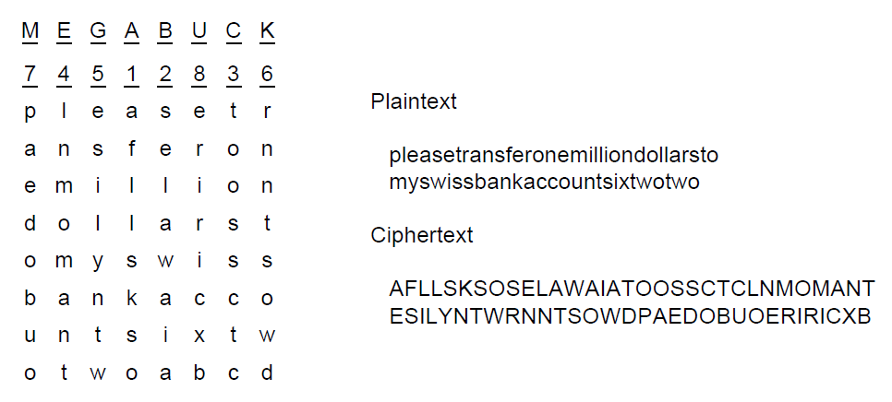
Encryption Methods
Transposition cipher: reorder the letters but do not disguise them

Slide 9
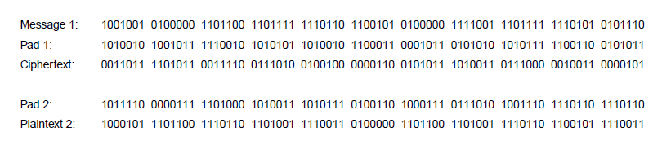
Encryption Methods
One Time pads: unbreakable cipher
Choose random bit string as a key.
Convert the plain text in to bit string.
Compute the XOR of these two strings bit by bit.

Slide 10
Symmetric Key Algorithm
Uses same key for encryption and decryption.
It uses block Cipher, which take n bit block of plain text as input and transform it using the key into n-bit block of cipher text.
Implemented either in hardware or in software.
P-box : transposition cipher (p -- permutation)
No computation . Only signal propagation
S –box : performs the substitution.
Examples : DES (Data Encryption Standards)
AES(Advanced Encryption Standard)

Slide 11
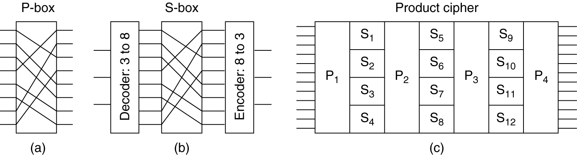
Product Ciphers
Basic elements of product ciphers. (a) P-box. (b) S-box. (c) Product.

Slide 12
DES(Data Encryption Standard)
In 1977, U.S adopted cipher developed by IBM.
Plain text is encrypted in blocks of 64 bits.
It uses 54 bit as a key.
It has 19 stages of algorithm.
First stage is key independent transposition on 64 bit plain text.
The last stage is the exact inverse of this transposition.
The stage prior to the last one exchanges the leftmost 32 bits with the rightmost 32 bits.
The remaining 16 stages are functionally identical but are parameterized by different functions of the key.

Slide 13
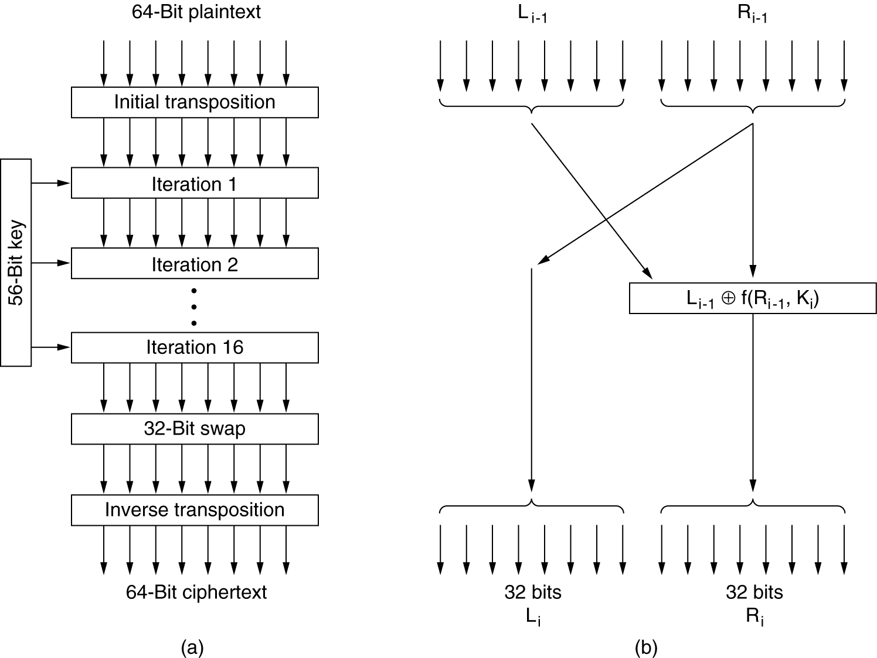
DES(Data Encryption Standard)

Slide 14
DES(Data Encryption Standard)
Process @ intermediate stages
Each stage takes two 32-bit inputs and produces two 32-bit outputs.
The left output is simply a copy of the right input.
The right output is the bitwise XOR of the left input and a function of the right input and the key for this stage, K_{i}.
The function consists of four steps.
First, a 48-bit number, E, is constructed by expanding the 32-bit R_{i} ₋ ₁ according to a fixed transposition and duplication rule.
Second, E and K_{i} are XORed together.
This output is then partitioned into eight groups of 6 bits each, each of which is fed into a different S-box.
Each of the 64 possible inputs to an S-box is mapped onto a 4-bit output. Finally, these 8 x 4 bits are passed through a P-box.

Slide 15
DES(Data Encryption Standard)
In each of the 16 iterations, a different key is used. Before the algorithm starts, a 56-bit transposition is applied to the key.
Just before each iteration, the key is partitioned into two 28-bit units, each of which is rotated left by a number of bits dependent on the iteration number.
K_{i} is derived from this rotated key by applying yet another 56-bit transposition to it.
A different 48-bit subset of the 56 bits is extracted and permuted on each round.
Whiting → more strengthen. XORing random 64 bit key with plain text. Again XORing after getting the cipher text.

Slide 16
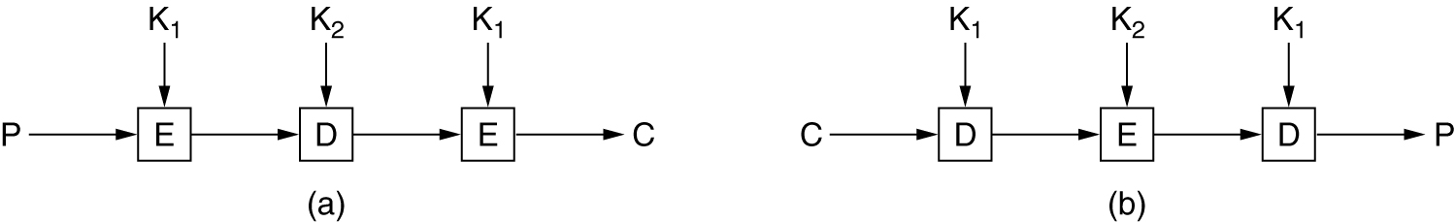
Triple DES
(a) Triple encryption using DES. (b) Decryption.

Slide 17
Public Key Algorithms
distributing the keys has always been the weakest link in most cryptosystems.?
In 1976, two researchers at Stanford University, Diffie and Hellman (1976), proposed a radically new kind of cryptosystem.
one in which the encryption and decryption keys were different, and the decryption key could not feasibly be derived from the encryption key.
In their proposal, the (keyed) encryption algorithm, E, and the (keyed) decryption algorithm, D, had to meet three requirements.
1. D(E(P)) = P.
2. It is exceedingly difficult to deduce D from E.
3. E cannot be broken by a chosen plaintext attack.

Slide 18
Public-Key Cryptography
public-key/two-key/asymmetric cryptography involves the use of two keys:
a public-key, which may be known by anybody, and can be used to encrypt messages, and verify signatures
a private-key, known only to the recipient, used to decrypt messages, and sign (create) signatures
is asymmetric because
those who encrypt messages or verify signatures cannot decrypt messages or create signatures

Slide 19
RSA
by Rivest, Shamir & Adleman of MIT in 1977
best known & widely used public-key scheme
based on exponentiation in a finite (Galois) field over integers modulo a prime
nb. exponentiation takes O((log n)³) operations (easy)
uses large integers (eg. 1024 bits)
security due to cost of factoring large numbers
nb. factorization takes O(e ^{log n log log n}) operations (hard)

Slide 20
RSA Algorithm
Method Summary
Choose two large primes, p and q
Compute n = p × q and z = ( p − 1) × (q − 1).
Choose number relatively prime to z call it d.
Find e such that e × d = 1 mod z.
Each plain text divided into P blocks , 0<= p <n
Encrypt C = P^{e}(mod n)
Decrypted P = C^{d}(mod n)

Slide 21
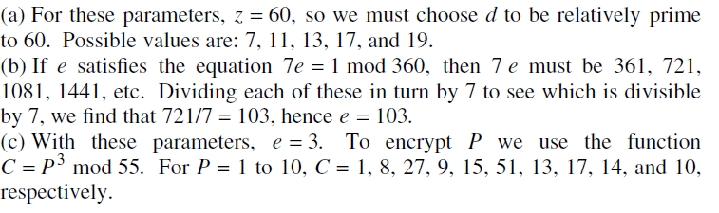
RSA Example
Using the RSA public key cryptosystem, with a = 1, b = 2, etc.,
If p = 7 and q = 11, list five legal values for d.
If p = 13, q = 31, and d = 7, find e.
Using p = 5, q = 11, and d = 27, find e and encrypt ''abcdefghij''.
vv

Slide 22
Why RSA Works
because of Euler's Theorem:
a^{ø(n)}mod N = 1
where gcd(a,N)=1
in RSA have:
N=p.q
ø(N)=(p-1)(q-1)
carefully chosen e & d to be inverses mod ø(N)
hence e.d=1+k.ø(N) for some k
hence : C^{d} = (Me)^{d} = M^{1+k.ø(N)} = M¹.(M^{ø(N)})^{q} = M¹.(1)^{q} = M¹ = M mod N

Slide 23
RSA Use
to encrypt a message M the sender:
obtains public key of recipient KU={e,N}
computes: C=Me mod N, where 0≤M<N
to decrypt the ciphertext C the owner:
uses their private key KR={d,N}
computes: M=C^{d} mod N
note that the message M must be smaller than the modulus N (block if needed)

Slide 24
RSA Example
Select primes: p=17 & q=11
Compute n = pq =17×11=187
Compute ø(n)=(p–1)(q-1)=16×10=160
Select e : gcd(e,160)=1; choose e=7
Determine d: de=1 mod 160 and d < 160 Value is d=23 since 23×7=161= 10×160+1
Publish public key KU={7,187}
Keep secret private key KR={23,17,11}

Slide 25
RSA Example
Find two large prime integers, p and q, and form product n = pq
Find a random integer, e, that is relatively prime to Ф(n) = (p-1)(q-1)
p and q are kept private, (n,e) are the public key
Message is partitioned into blocks, b, such that b < n
Each block is encrypted using the equation: c = b^{e} mod n
For the private key, calculate integer d which is the modular inverse of e
for Ф(n), or e * d mod Ф(n) = 1
Once d is calculated it becomes your private key and all records of
p and q should be destroyed
Each encrypted block, c, is decrypted using the equation: b = c^{d} mod n
p = 61, q = 53, n = 3233, Ф(n) = 3120, e = 17, d = 2753
encrypt(123) = 123¹⁷ mod 3233 = 855
decrypt(855) = 855²⁷⁵³ mod 3233 = 123

Slide 26
Birthday Attack Problem
Every one thinking that 2^{m} operations to subvert an m-bit digest.
By using birthday attack, we will subvert that with 2^{m/2} operations.
It includes the probability concepts.
Class has a strength 23 student.
Pairs → (23 * 22) /2 = 253
Each having the probability of 1/365

Slide 27
Birthday Attack Problem
As an example, consider the scenario in which a teacher with a class of 30 students asks for everybody's birthday, to determine whether any two students have the same birthday (corresponding to a hash collision as described below; for simplicity, ignore February 29). Intuitively, this chance may seem small. If the teacher picked a specific day (say September 16), then the chance that at least one student was born on that specific day is , about 7.9%. However, the probability that at least one student has the same birthday as any other student is around 70% (using the formula for n = 30).

Slide 28
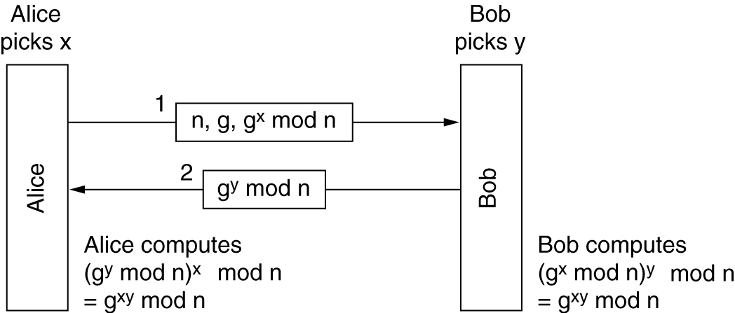
Establishing a Shared Key: The Diffie-Hellman Key Exchange
The Diffie-Hellman key exchange.

Slide 29
Example
To make the above example more concrete, we will use the (completely unrealistic) values of n = 47 and g = 3.
Alice picks x = 8 and Bob picks y = 10.
Alice's message to Bob is (47, 3, 28) because 3⁸ mod 47 is 28.
Bob's message to Alice is (17).
Alice computes 17⁸ mod 47, which is 4.
Bob computes 28¹⁰ mod 47, which is 4.
Alice and Bob have independently determined that the secret key is now 4.
Trudy has to solve the equation 3^{x} mod 47 = 28, which can be done by exhaustive search for small numbers like this, but not when all the numbers are hundreds of bits long.

